Slide 1
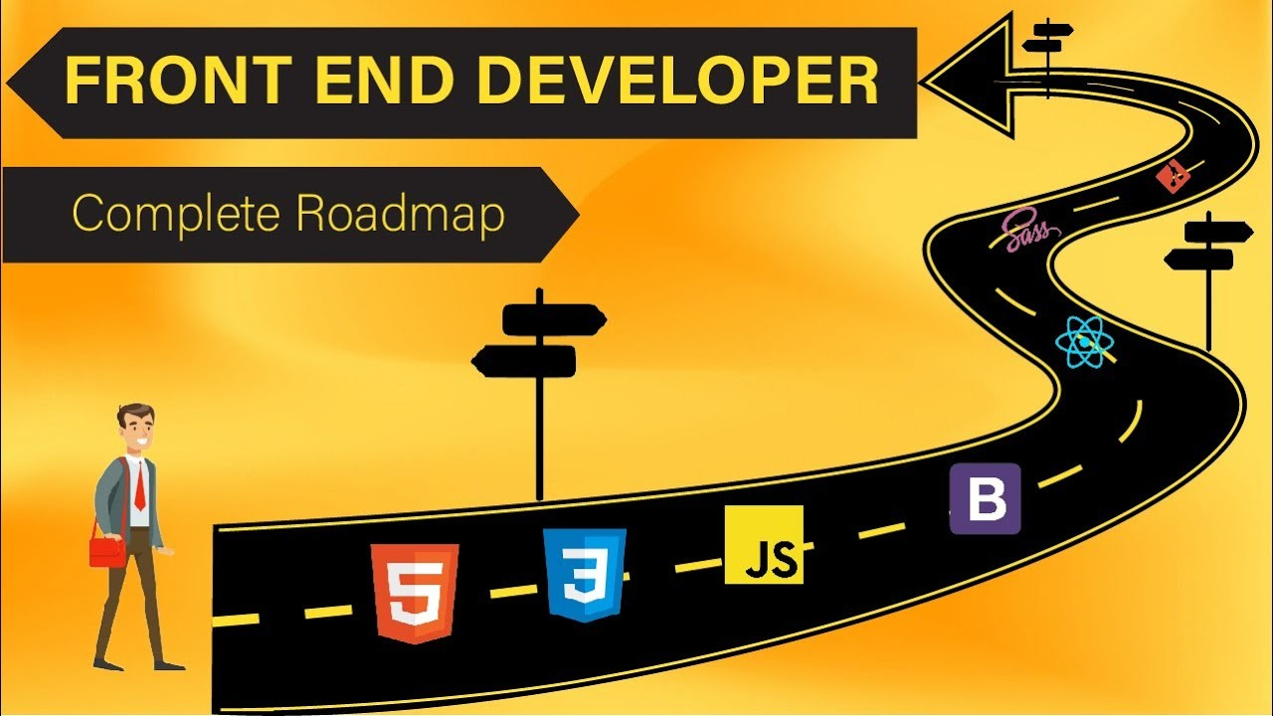


Slide 2
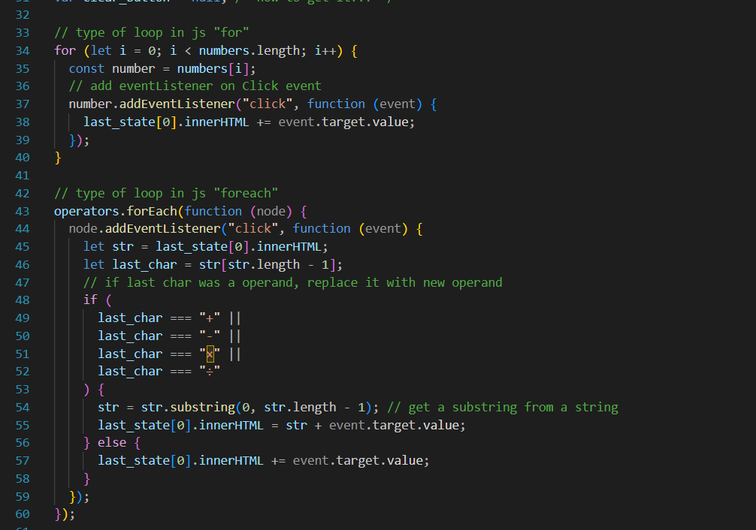

Slide 3
Java script
Tutorial
JavaScript Tutorial (w3schools.com)

Slide 4
What is js?
Frontend
Full stack
Backend
The most popular programming language ever!

Slide 5
What is node?
Embedded JS in C++ program.

Slide 6
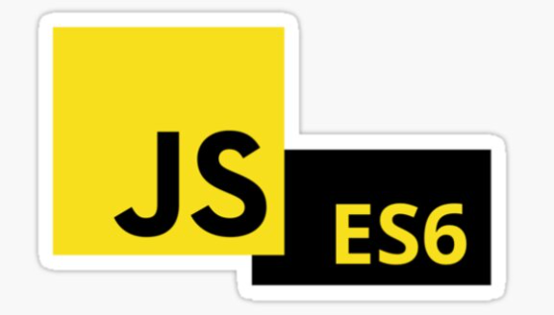
ECMAScript vs JavaScript

Slide 7
Let’s see js in action!

Slide 8

Separation of concern
Example: A messy House

Slide 9
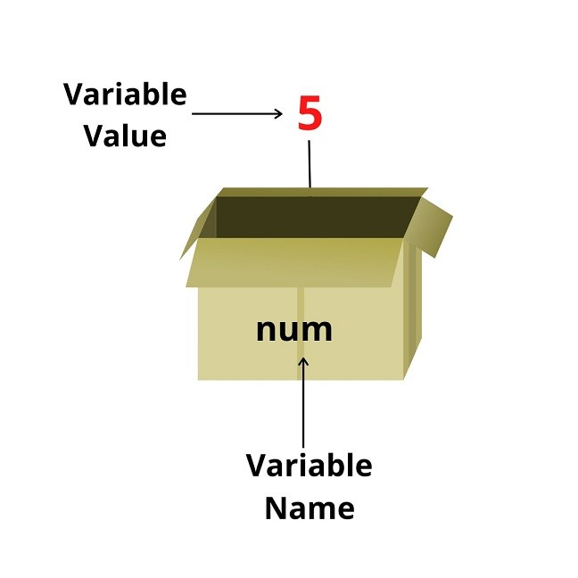
Variable
Store Data

Slide 10
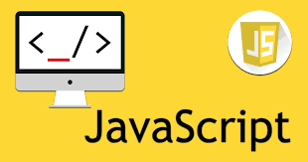
JS concepts

Slide 11
